Slide 1
Gender Differences in Organization Value Fit and Job Satisfaction
Rucha Rane, Jenny Wang, & Anna Zabinski
MGS 9920- Fall 2016

Slide 2
Agenda
Theoretical Background
Constructs
Research Question & Hypothesis
Methodology
Results
Discussion
Future Directions for Research

Slide 3
Theoretical Background
Gender Role Theory (Eagley & Steffan, 1986)
Male Characteristics: ambitious, aggressive, dominant
Female Characteristics: helpful, communal, sensitive
Values (Blood, M ., 1969)
Meanings individuals attach to perceived job characteristics
Job Satisfaction (Kalleberg A., 1977)
A worker’s job satisfaction related to various dimensions at work and work values
Notes:
Gender Role Theory suggest that different traits and characteristics are culturally imposed upon men and women.
Eagley and Steffan found that male and female employees were expected to behave differently. Men were expected to be …. Whereas women were expected to act more ….
Six dimensions of work that are : 1. Intrinsic 2. Convenience 3. Relationship with coworkers 4. Opportunities job provides for a career 5. Resource Adequacy 6. Job Rewards
A worker's level of job satisfaction is a function of the range of specific satisfactions and dissatisfactions that he/she experiences with respect to the various dimen- sions of work and work values

Slide 4
Constructs
Value Fit (Kalleberg A., 1977)
Work-No inherent meaning, individuals impute meaning to their work activity
Conceptions of what is desirable with respect to the work activity
Job Satisfaction
Higher job satisfaction: partly a congruence between individual and institutional goals (Kalleberg A., 1977)
Work Values influence and precede job satisfaction, no causal link however (Blood, M ., 1969)
Notes:
Value Fit: Work has no inherent meaning, rather individuals impute meaning to their work activity. Work values reflect the individual's awareness of the condition he seeks from the work situation, and they regulate his actions in pursuit of that condition. They thus refer to general attitudes regard- ing the meaning that an individual attaches to the work role as distinguished from his satisfaction with that role
Job Satisfaction : It is thus "the pleasurable emotional state resulting from the appraisal of one's job as achieving or facilitating the achievement of one's job values" (Locke, 1969).
This view of the process underlying the variation in job satisfaction implies that two types of factors are operative: perceived job characteristics, which represent the amount of satisfaction available from particular dimensions of work, and work values, which represent the meanings that individuals attach to these perceived job characteristics. In order to examine this process empirically, it is necessary to develop measures of these factors.

Slide 5
Do women to have higher perceived organization-value fit and job satisfaction than men?
Notes:
Given what we know about Gender Role Theory and Job Satisfaction, can we expect women to have higher perceived organization-value fit and job satisfaction?

Slide 6
Hypothesis & Theoretical Model
H1: Females will perceive higher person-organization fit than males.
H2: Person-Organization Value Fit will be positively related to Job Satisfaction.
H3: Person-Organization Value Fit will mediate the relationship between gender and Job Satisfaction?
H1
Perceived Person-Org Value Fit
H2
H3
Female
Job Satisfaction

Slide 7
Methodology
Data was collected by Canadian Policy Research Networks (CPRN) from February to March 2000, with an additional 8 focus groups conducted in June 2000
It is a survey of 2 500 employed Canadians with 175 questions
It is meant to be a nationally representative sample of working Canadians
The data set includes questions about work characteristics, employee health, and demographics

Slide 8
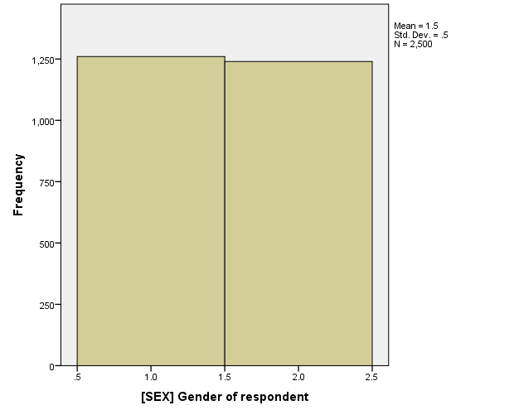
Results: Descriptive Statistics
Males
Females
325
51.4%
307
48.6%
N= 632
Gender of Respondents
Notes:
Large sample size with almost equal divide between male and female participants

Slide 9
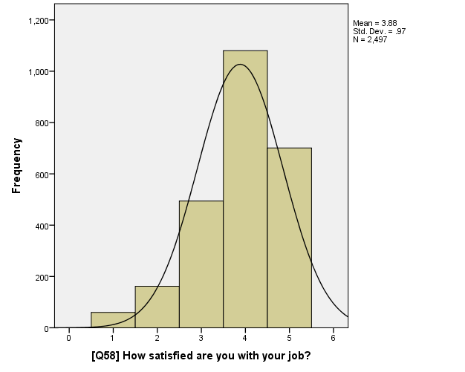
Results: Descriptive Statistics
Job Satisfaction Distribution
230
Likert Scale:
1 (Very Dissatisfied) to
5 (Very Satisfied)
110
173
85
32
N= 632
“How satisfied are you with your job?”
Notes:
Skewed left

Slide 10
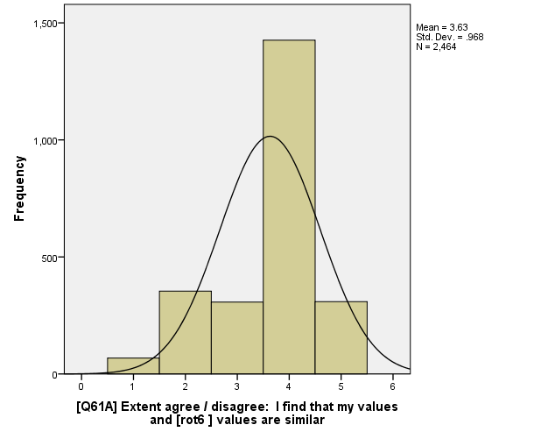
Results: Descriptive Statistics
Person-Org Value Fit Distribution
317
Likert Scale:
1 (Strongly Disagree) to
5 (Strongly Agree)
131
85
57
35
N= 632
Extent agree/disagree: “I find that my values and [my organization’s] values are similar.”
Notes:
Skewed left

Slide 11
Results: Statistical Analysis
Correlations
Variable | M | SD | N | 1 | 2 | 3
Gender | 1.49 | 0.500 | 632 | 1 | - | -
2. Job Satisfaction | 3.48 | 1.084 | 630 | 0.027 | 1 | -
3. Values | 3.37 | 1.083 | 625 | 0.086* | 0.410** | 1

Slide 12
Results: Statistical Analysis
Regression
“A Path” (Testing H1)
Beta Coefficient = .187, p=.031, St. Error= .086
“B Path” (Testing H2)
Hold Gender Constant
Beta Coefficient= .412, p=.000, St. Error= .037
.187*
Perceived Person-Org Value Fit
.412**
.058
Female
Job Satisfaction
*= p<.05, **=p<.01
Notes:
Ran a regression testing the model.
First, we tested the “A Path” of the model and found: Beta Coefficient = .187, p=.031, St. Error= .086
----Support for H1, Females will perceive higher person-organization fit than men.
Then, we tested the “B Path” of the model, while holding gender constant, and found Beta Coefficient= .412, p=.000, St. Error= .037
-----Support for H2, Person-Organization Value Fit will be positively correlated with Job Satisfaction.
.058 is the direct effect

Slide 13
Results: Statistical Analysis
Regression
Sobel Test (Sobel, 1982)
Purpose: To test whether a perceived person-org value fit carries the influence of ‘female’ to job satisfaction
Gives a critical ratio as a test of whether the indirect effect of ‘female’ on job satisfaction via the mediator is significantly different from zero.
Value: 2.16, p=.031, St. Error= .036
Perceived Person-Org Value Fit
Female
Job Satisfaction
2.16*
*= p<.05, **=p<.01
Notes:
Finally, we ran a Sobel Test.
Purpose: To test whether a perceived person-org value fit carries the influence of ‘female’ to job satisfaction
We ran the Sobel Test in a program that required both the A and B path regression coefficients and standards errors, respectively.
It gives a critical ratio as a test of whether the indirect effect of ‘female’ on job satisfaction via the mediator is significantly different from zero.
I.E., the Sobel Test will indicate whether or not the mediation is significant
We got a value of 2.16 which is significant at the p<.05 level
----Supporting H3, Person-Organization Value Fit will mediate the relationship between gender and Job Satisfaction?

Slide 14
Discussion & Future Directions
All hypotheses were supported
Females, compared to males, tend to have shared values with the organizations they are employed at
Having shared personal values with the organization one is employed at is associated with Job Satisfaction
Values mediate the relationship between gender and Job Satisfaction, but gender does not directly predict Job Satisfaction
Possible future lines of research include:
Do potential female employees consciously self-select out of working with companies that do not match their personal values?
What specific values are considered when employees determine whether their personal values match their organizations?

Slide 15
Questions or Suggestions?
Thank you!

